Slide 1

LOCATION FINDING USING PHOTOS THROUGH ITS META DATA
Project Name

Slide 2





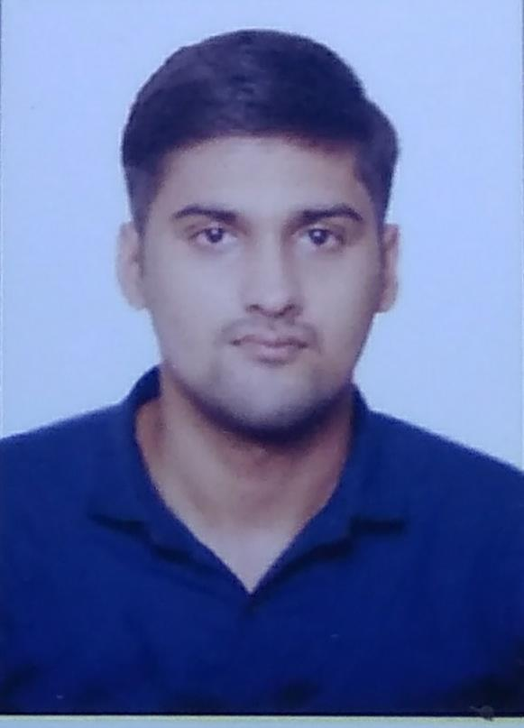
REGENT EDUCATION AND RESEARCH FOUNDATION
GROUP MEMBERS
GUIDE NAME
ANUSHREE SAHA
26300119006
MR. ATANU KUMAR DAS
MANISH PATHAK
26300119026
SHIVAM MISHRA
26300119025

Slide 3

ACKNOWLEDGEMENT
We would like to express our gratitude to our project mentor Mr. Atanu Kumar Das Sir for providing support and guidance.
We would also like to express our gratitude to our HOD Mr. Subhankar Ghosh Sir.

Slide 4

INTRODUCTION
There is a lot about AI , and to understand this, we started our analysis on a widely used app called Google Maps. Google Maps is a web mapping platform and consumer application offered by Google.
After understanding the basic idea, we thought of adding our contribution to it and hence went through the app minutely. Then, in this process, we got to know more about Google Lens. Google Lens is an AI-powered technology that uses your smartphone camera and deep machine learning to not only detect an object in front of the camera lens, but understand it and offer actions such as scanning, translation, shopping, and more.
We continued our work on finding more about the photos captured and how they can be used in collecting data. When viewing images on the Internet, one might have noticed that some websites provide valuable information related to those images, such as their exposure settings, camera brand, etc. This information, known as "EXIF Data," can be an important source of knowledge in figuring out how photographers capture images and what tools they use in the process. So the next thing for us to learn about was EXIF data.

Slide 5

What is EXIF Data?
Exchangeable Image File Format (EXIF) is a standard that defines specific information related to an image or other media captured by a digital camera. It is capable of storing such important data as camera exposure, date and time the image was captured, and even GPS location.
Nowadays, every modern digital camera has the capability to record this information, along with many other camera settings and other relevant data, right into photographs. These settings can then be later used to organize photographs, perform searches, and provide vital information to photographers about the way a particular photograph was captured. Such stored data is called "EXIF Data", and it is comprised of a range of settings such as ISO speed, shutter speed, aperture, white balance, camera model and make, date and time, lens used, focal length, and much more.
After putting all this information in a place and linking them up, we finally got the objective for our project and decided to work on it.

Slide 6
OBJECTIVE : To find a location using photos through its metadata.
So our intention is to create a platform that works similar to Google Maps. It would help to find the route and location of a place, but the interesting part was to do it using an image as an input instead of text. Generally, we type a place name and search for its location and route, but here the twist was to use an image as a user input instead of typing the place name. An image with exif data would store all the required information, like altitude, longitude , latitude, and much more. That data would help us find the location or route of the place. And hence, we started working on it.

Slide 7

OUR PLAN
PHASE–1
PHASE–2
PHASE–3
Writing code for extracting exif data from images
Storing coordinates of the place from given image
Taking coordinates as input and showing the place where image was taken on the map
Creating an user-friendly interface for our project

Slide 8

SOFTWARE USED
Vscode:
INTRODUCTION:
Visual Studio Code, also commonly referred to as VS Code, is a source-code editor made by Microsoft for Windows, Linux and macOS. Features include support for debugging, syntax highlighting, intelligent code completion, snippets, code refactoring, and embedded Git. Users can change the theme, keyboard shortcuts, preferences, and install extensions that add additional functionality. WHY WE USE:->we use Vscode as ide because it provides great tool support for web technologies like Html, Css , JavaScript.
Chrome Browser:
INTRODUCTION:
Google Chrome is a cross-platform web browser developed by Google. It was first released in 2008 for Microsoft Windows, built with free software components from Apple Web Kit and Mozilla Firefox. It was later ported to Linux, macOS, IOS, and Android, where it is the default browser. WHY WE USE: we use chrome browser for website testing and also for presentation of website.

Slide 9

STEPS AND METHOD INVOLVED
Implementation:
Import image sub module from exif module.
Reading image path in binary
Taking user input
Checking if image has exif data or not
Fetching the data and printing according to user input
There are many types of metadata but in this we are only focusing on Exif metadata

Slide 10
IMPORTING IMAGE SUB MODULE FROM EXIF MODULE
READING THE IMAGE PATH IN BINARY
CHECKING IF THE IMAGE HAS EXIF DATA OR NOT
START
PRINT THE OUTPUT ACCORDINGLY
(1, 2, 3, 4)
TAKING USER INPUT
NO
IS INPUT 0 ?
END
FLOW CHART
YES

Slide 11
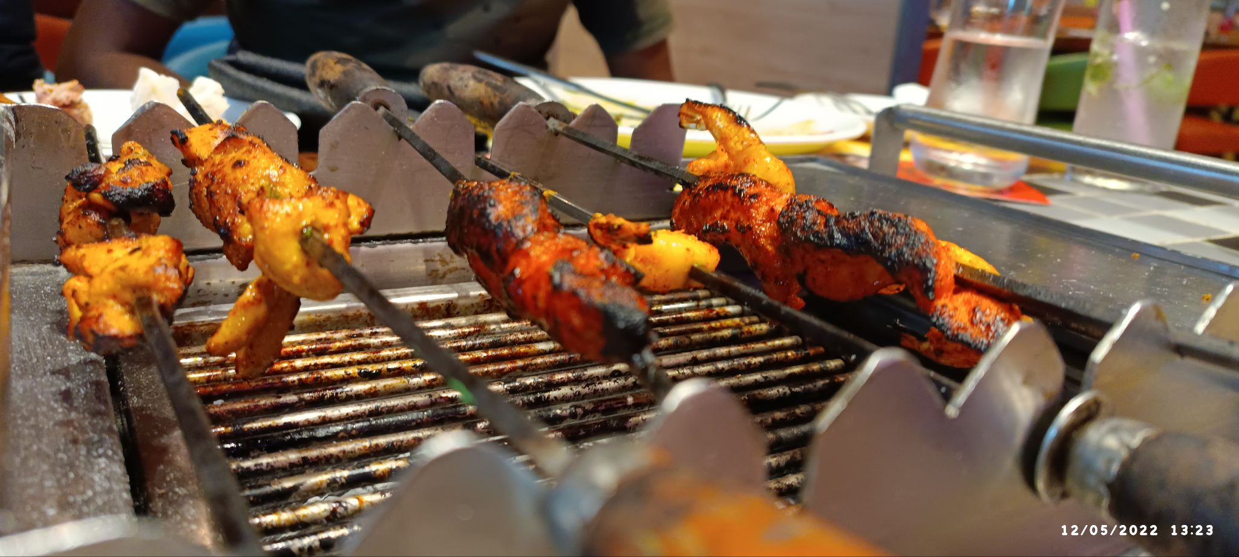
CODE OVERVIEW
Programming language:-- Python
The Python library used in this project is exif, which happens to be the namesake of the Exif format.
We start by installing exif with this command:
For this project, we will use this photo

Slide 12
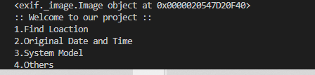
WE ARE CONVERTING IMAGE PATH INTO BINARY

Slide 13
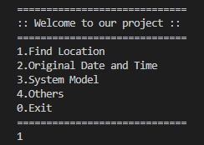
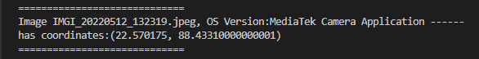
OUTPUT FOR USER INPUT– 1

Slide 14
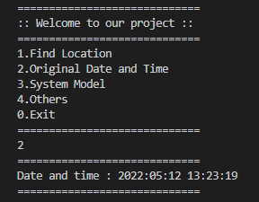
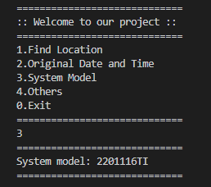
OUTPUT FOR USER INPUT– 2
OUTPUT FOR USER INPUT– 3

Slide 15
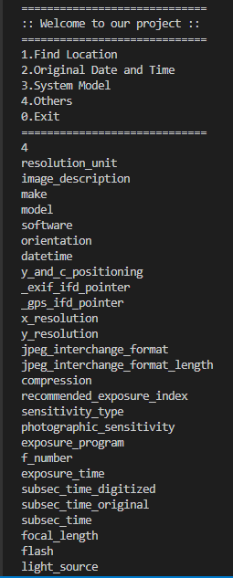
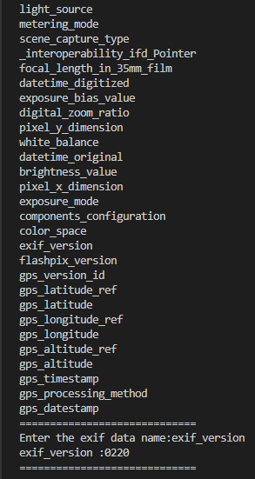
OUTPUT
FOR
USER
INPUT– 4

Slide 16
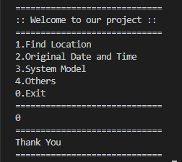
OUTPUT FOR USER INPUT– 0

Slide 17
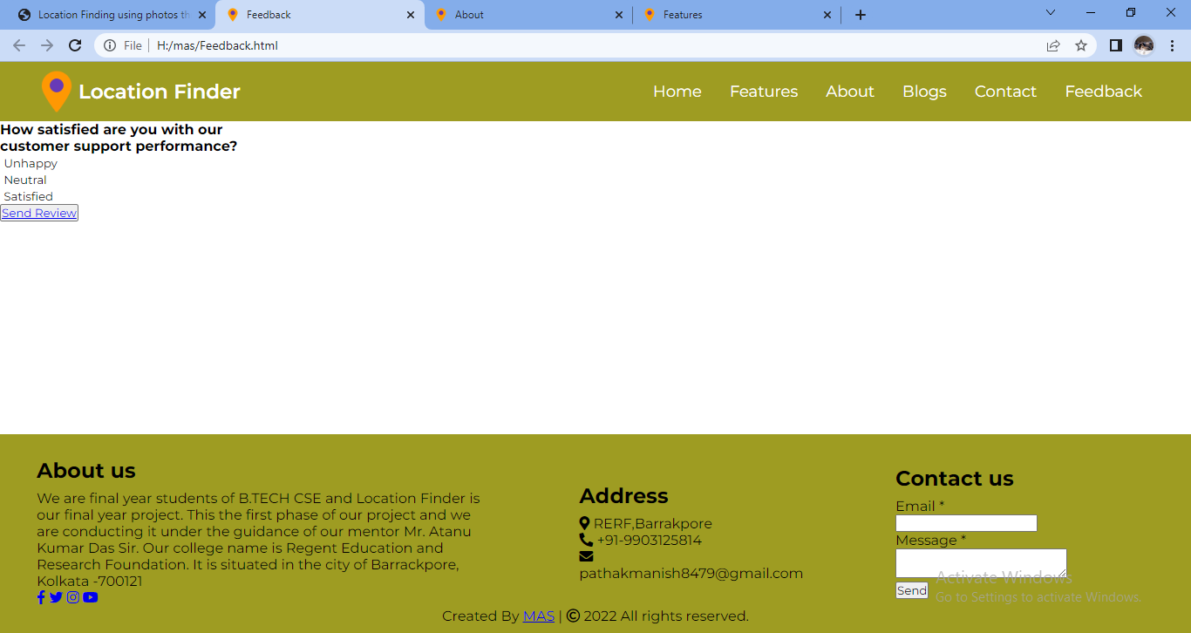
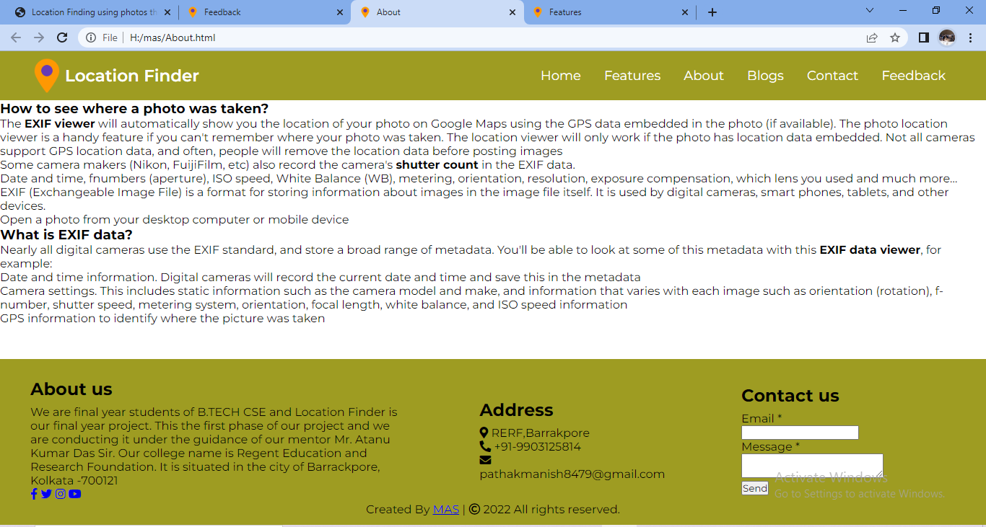
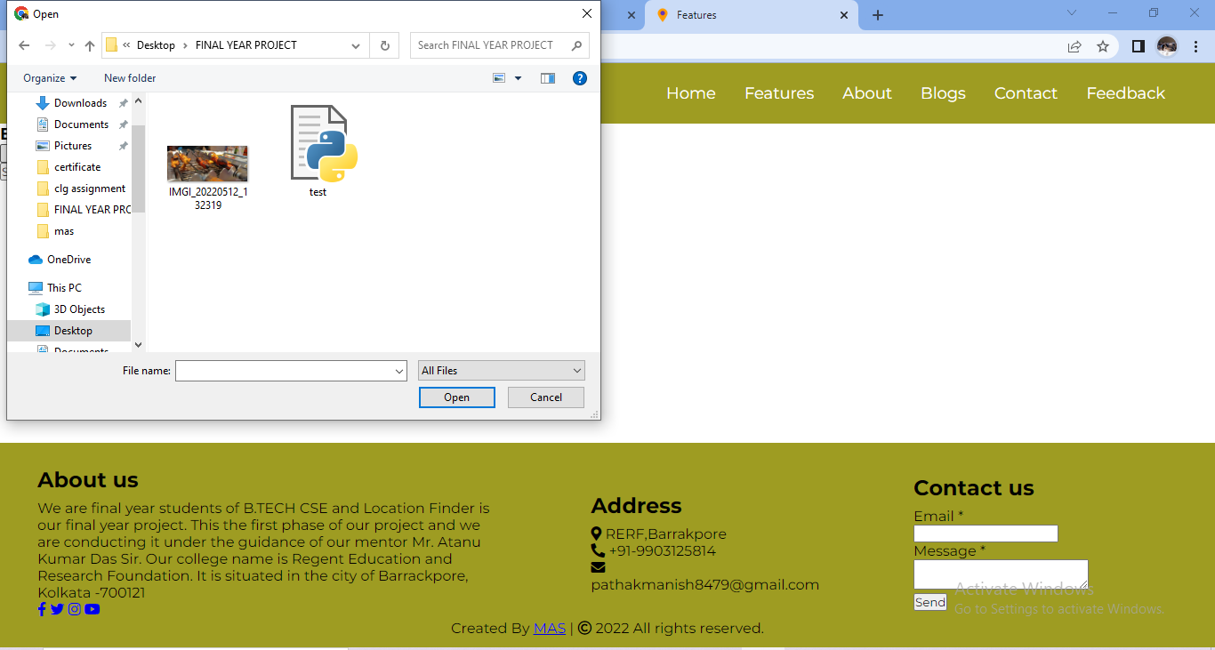

Slide 18

FUTURE WORK
In future plan, we would implement the method to trace image on maps. the exact location, name of the place , routes to that places and many more features will be added as mentioned in the introduction of the project.
Also we will add various tools in it like stenography; which will help in encoding the original image and will protect the image data from getting exposed.
Further we are looking forward to create user-friendly interface for our project; that would probably be a website ,where all these features will be provided.

Slide 19
CONCLUSION
On summing up , the project provides location and actual time of capturing photo. It also helps to fetch important exif data from the image provided.
The project promises a safe and user-friendly interface on internet for positive uses only.

Slide 20

REFERENCES
https://betterprogramming.pub/visualising-photo-geolocation-data-using-python-73ac47059112
https://www.codingnepalweb.com/responsive-navigation-menu-bar-css-flexbox/
https://www.codingnepalweb.com/responsive-footer-section-html-css/
https://www.geeksforgeeks.org/how-to-create-links-to-sections-within-the-same-page-in-html/
https://pypi.org/project/exif/
https://www.techbout.com/find-location-where-photo-was-taken-17094/
https://www.photographymad.com/pages/view/exif-data-explained

Slide 21



THANK YOU
Anushree Saha
Manish Pathak
Shivam Mishra
9903125814
pathakmanish8479@gmail.com

